Slide 1





OntoSof Tutorial A Distributed Semantic Registry for Scientific Software
Daniel Garijo, Yolanda Gil
Information Sciences Institute and Department of Computer Science
@dgarijov dgarijo@isi.edu
Slides available: https://goo.gl/J1pBqQ
http://www.ontosoft.org
Building Block

Slide 2
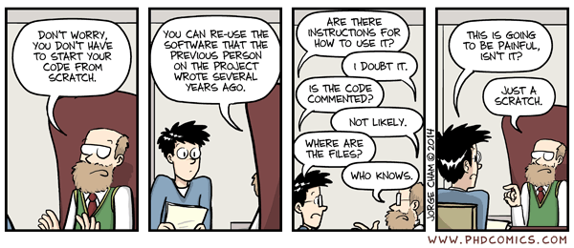
We have all been here…

Slide 3
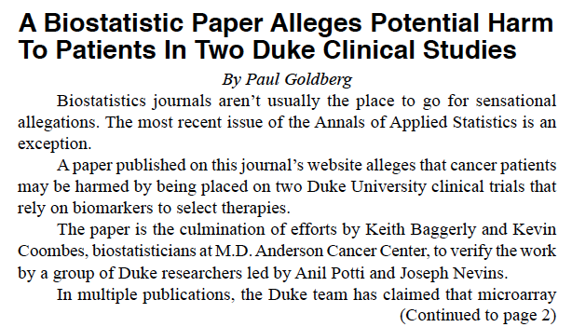

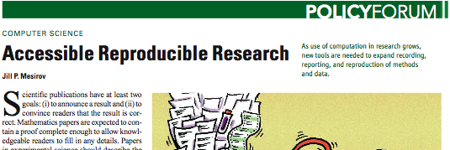


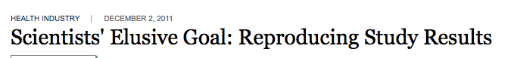
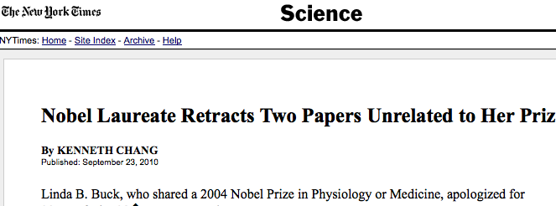
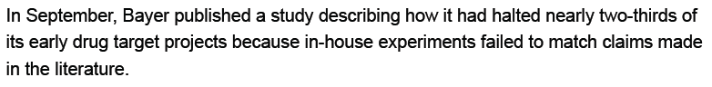
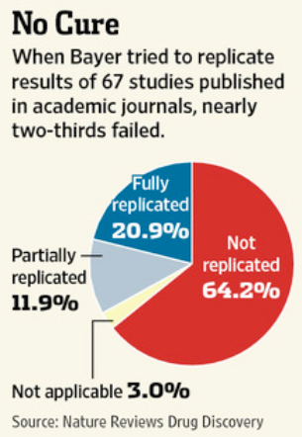
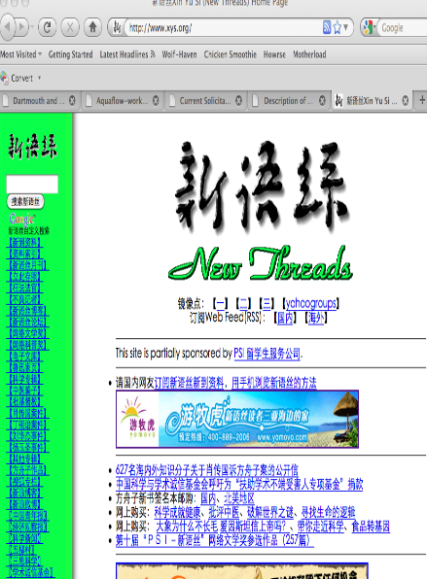
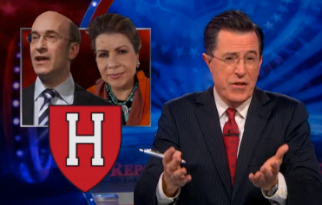
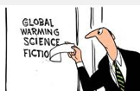
The Value of Software: Reproducibility
Human lives
Reliability
Financial
Financial
Scientific
integrity
Trust

Slide 4
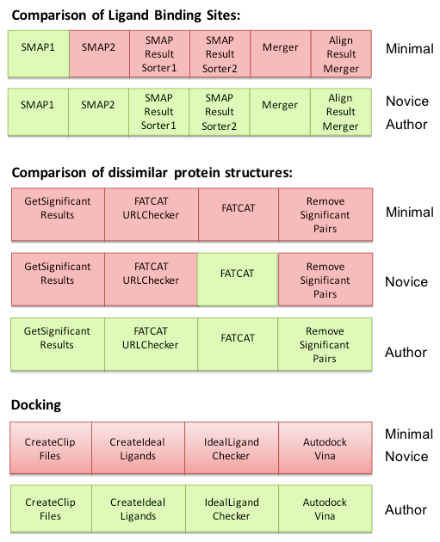
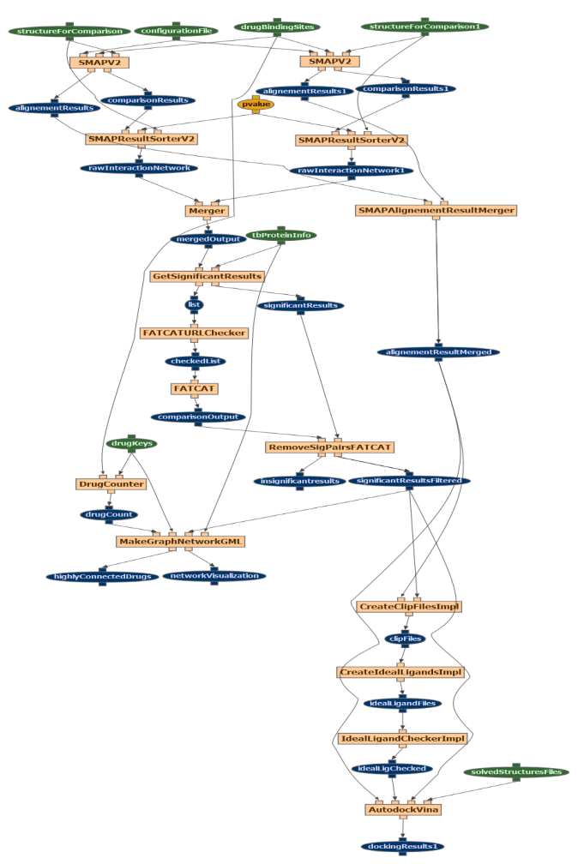
Quantifying the Value of Software through “Reproducibility Maps” [Bourne & Gil et al 12]
Work with P. Bourne of UCSD
2 months of effort in reproducing published method (in PLoS’10)
Authors expertise was required
Comparison of ligand binding sites
Comparison of dissimilar protein structures
Graph network generation
Molecular Docking

Slide 5




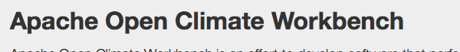



Software Today
There are repositories of domain specific software (e.g., geosciences)
There are general software repositories with no standard metadata (or curation process)
Most scientists are not aware of the value of their software
Notes:
CSDMS: Community Surface Dynamics Modeling System
CGI: Computer Generated Imagery
ESMF: Earth System Modeling Framework

Slide 6

“Dark Software”
Models that are not published
Eg from a PhD thesis
Data preparation software
Data pre-processing and QC can take up to 80% of a project’s effort
Visualization software
“Dark Software” is the counterpart of “Dark Data” [Heidorn 2008]

Slide 7
Why Is Software Not Shared?
“No one would use my code if I shared it”
“My code is really bad”
“My code is not ready to be shared”
“Sharing my software will take a lot of time”
“I won’t get anything out of sharing my software”
“I’ve shared software before, bad things happened”
“I work for the government”
“I want to commercialize my software”
“I don’t want anyone to sell my software”
“I don’t know where to start!”

Slide 8






Software Repository vs Software Registry
Software repository
Code resides there
Support software evolution
Support groups of developers of open source software
Software registry
Capture metadata
Useful structured information about the code
CRAN

Slide 9
OntoSoft
http://ontosoft.org
http://imcr.ontosoft.org
Registry for software
Complements code repositories
Scientist-centered software metadata
Community curated software metadata
Training scientists on best practices

Slide 10
OntoSoft Metadata Categories

Slide 11
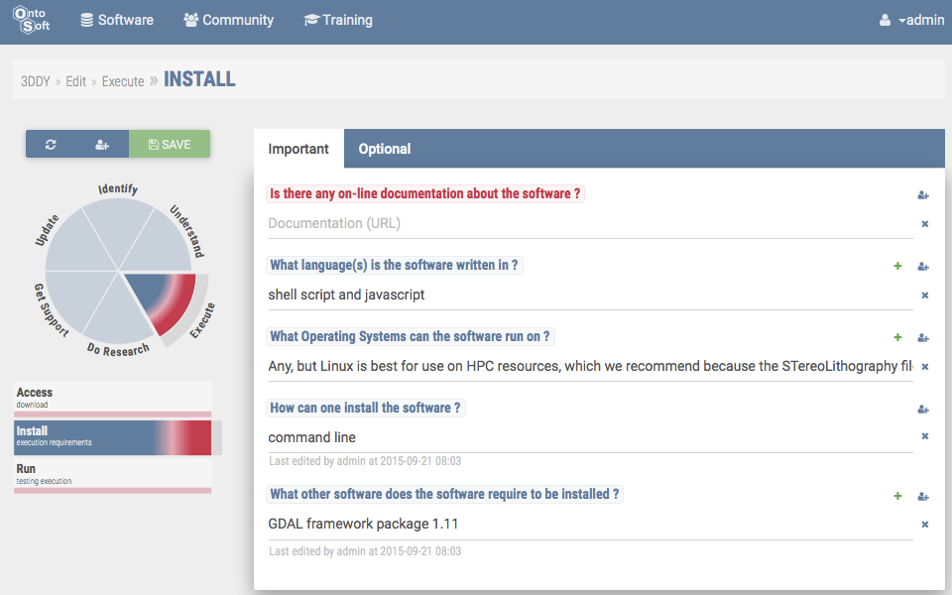
Describing Scientific Software in OntoSoft
http://www.ontosoft.org/portal
Set permissions for 3DDY
Metadata properties
organized into categories that make sense to scientists
Metadata can be exported in several formats (HTML, RDF, JSON)
Metadata properties collected through simple questions
Metadata for 3DDY Software
Indicators of metadata completeness
Automatic import of metadata from other repositories

Slide 12
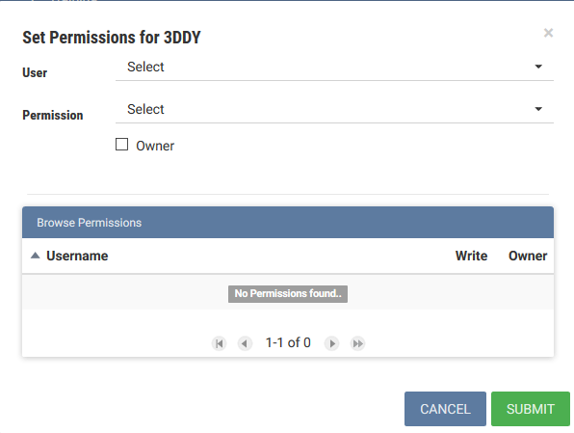
Access control
Setting permissions for editing 3DDY metadata
Users and permissions for the 3DDY software component
W3CWeb access control Ontology

Slide 13
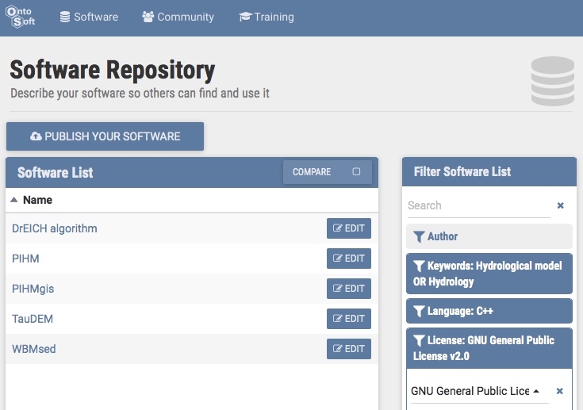
Finding Software with OntoSoft
Currently >600 entries, many imported from CSDMS, C4P, …

Slide 14
Comparing Alternatives with OntoSoft
Select software and features, get a comparison table

Slide 15
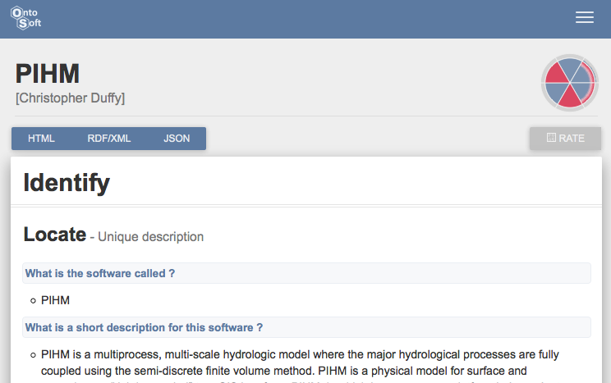
Publishing Software Metadata with OntoSoft
Publish metadata as HTML from OntoSoft and add pointer from software repository

Slide 16
OntoSof Tutorial
How to use OntoSoft in a few steps

Slide 17
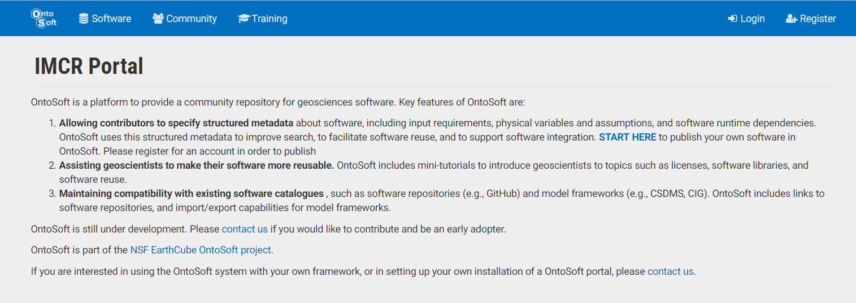
Registering in OntoSoft
Go to http://imcr.ontosoft.org

Slide 18
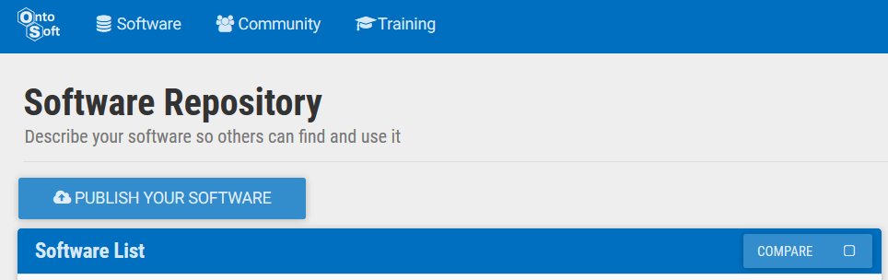
Adding a software entry

Slide 19
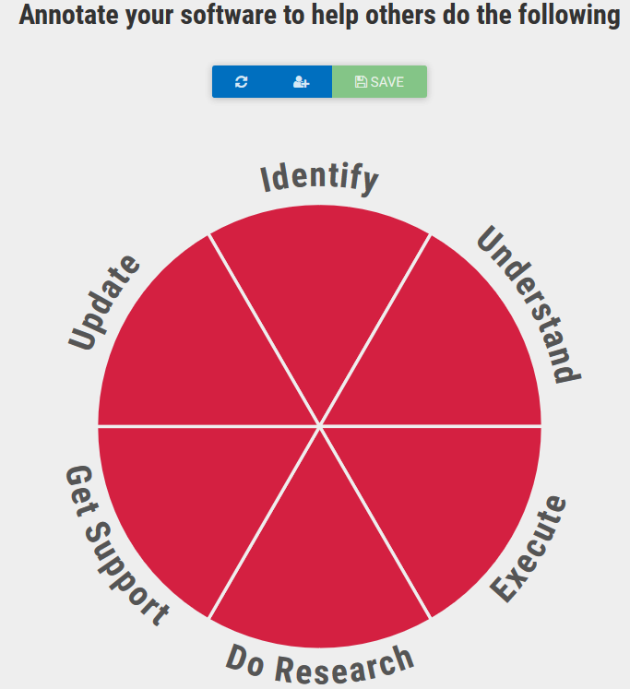
Adding a software entry (2)
Fill in the different metadata fields by clicking on the different sections.
The red color indicates the level of metadata completion of a category

Slide 20
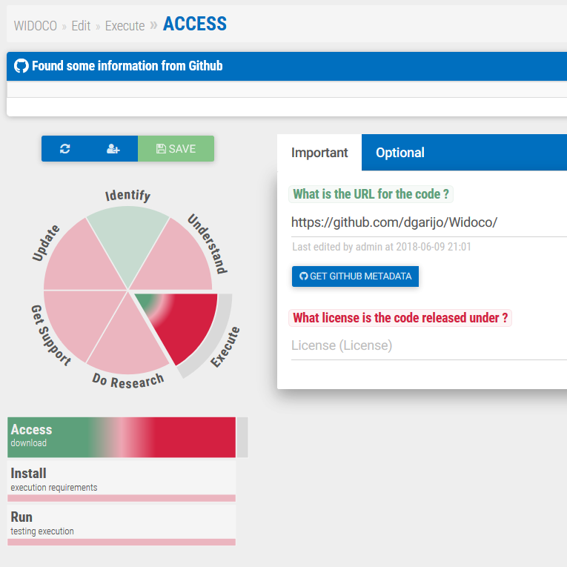
Importing metadata from GitHub
Select “Execute” and then “Access”
Insert your GitHub project URL on the first field
Clickl on “Get GitHub Metadata”

Slide 21
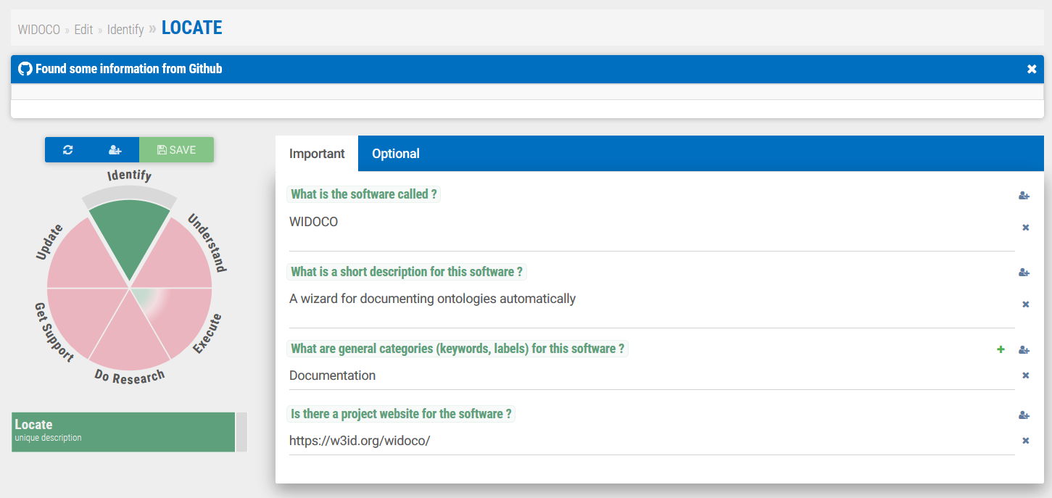
Describing a software entry
Click on a category you want to describe (e.g., identify)
Answer the questions
Some questions allow for adding multiple responses (e.g., keywords)

Slide 22
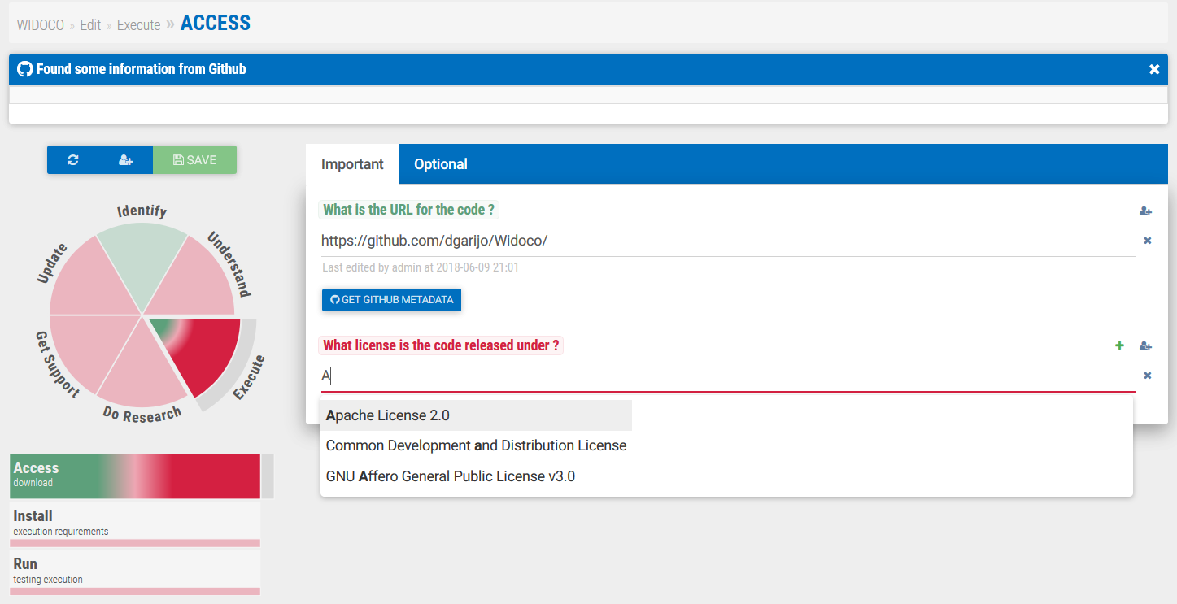
Describing a software entry (2)
Some fields allow autocompleting metadata from existing information (e.g., licenses)
Just start writing to show if there are existing licenses that overlap with yours

Slide 23
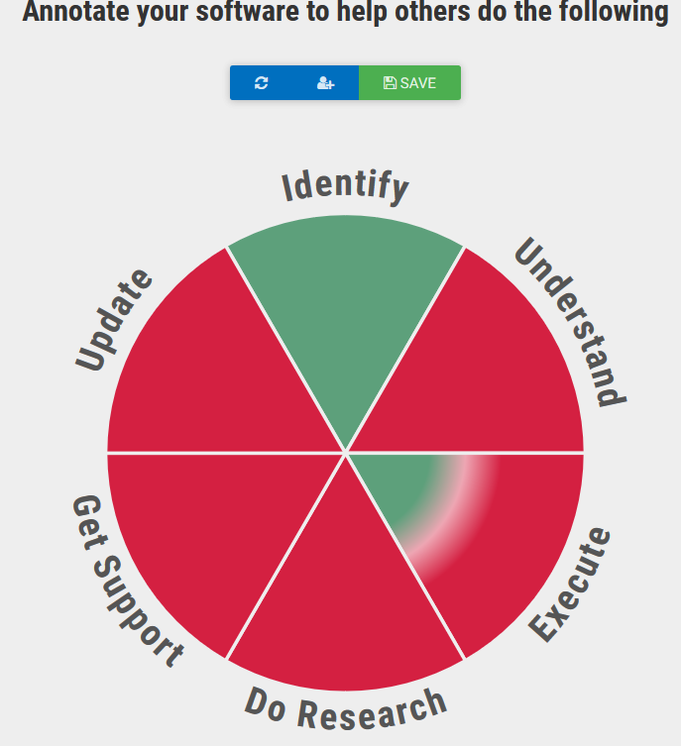
Allowing others to change your metadata

Slide 24
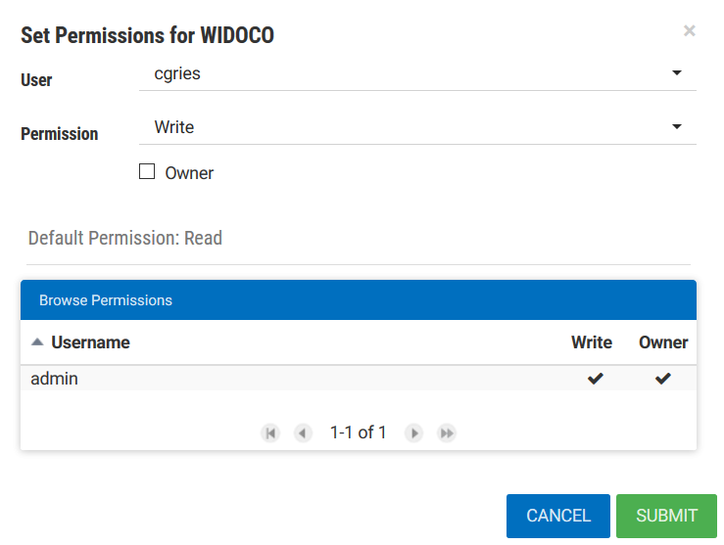
Allowing others to change your metadata (2)

Slide 25
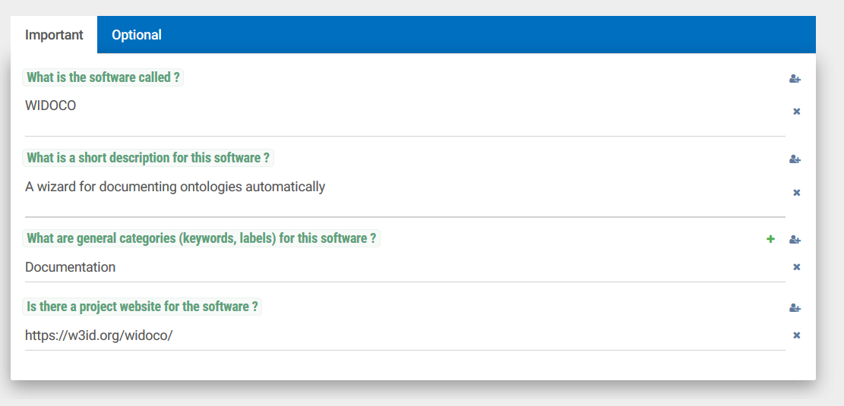
Allowing others to change your metadata (3)
You can set individual properties to be changed by another user

Slide 26
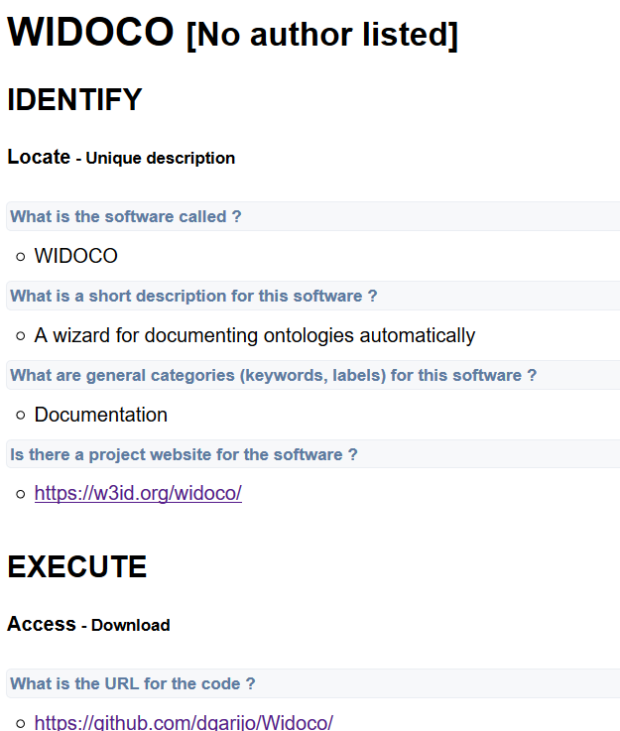
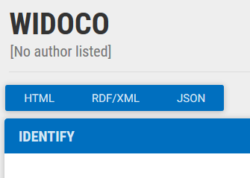
Downloading your software metadata
Click on the serialization you want to preserve
Save it to your disk!

Slide 27
Finding Software with OntoSoft

Slide 28
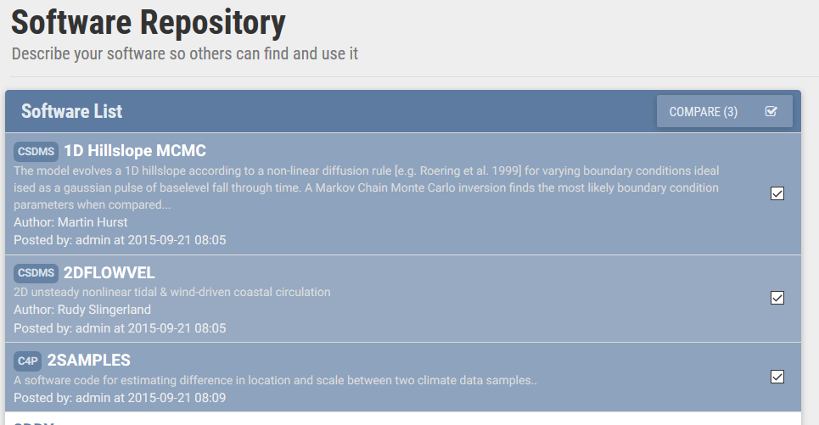
Comparing Software
Click on “compare” box to enable the comparison mode
Select entries (click on their boxes)
Click on “compare” button

Slide 29
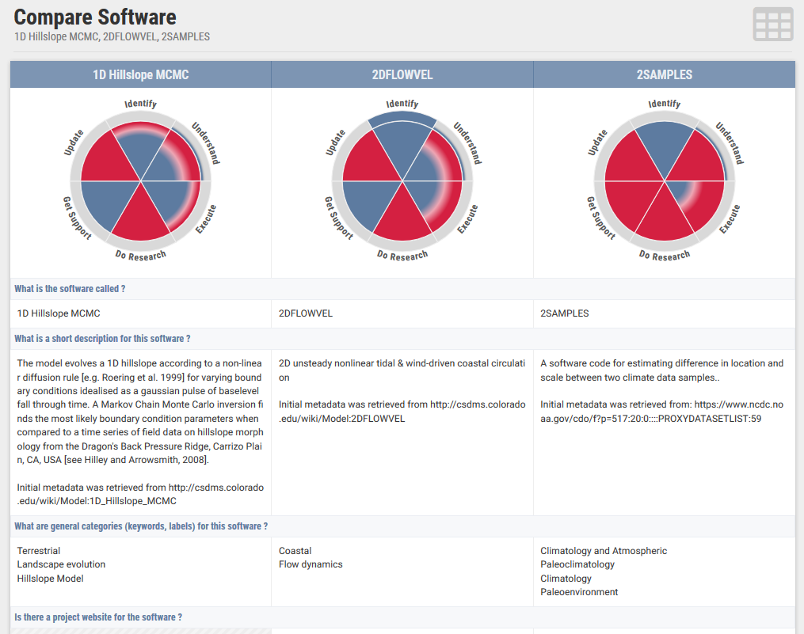
Comparing Software (2)

Slide 30

Acknowledgements
ICER-1440323
ICER-1343800
http://www.ontosoft.org
http://www.ontosoft.org/software
http://www.ontosoft.org/portal
http://www.ontosoft.org/gpf
The OntoSoft project team includes Chris Duffy (PSU), Chris Mattmann (JPL), Scott Pechkam (CU), Ji-Hyun Oh (USC), Varun Ratnakar (USC), and Erin Robinson (ESIP)
Thank you to James Howison (UT), Lisa Kempler (Matworks), and Greg Wilson (Software Carpentry) for their feedback on best practices for software sharing
Thank you to the scientists and other colleagues that have contributed ideas and asked hard questions about software stewardship
Thank you to the National Science Foundation and the EarthCube program for supporting this work
Yolanda Gil, Daniel Garijo, Saurabh Mishra, Varun Ratnakar eScience 2016

